Slide 1

Lecture_5
SAS Procedures
Matthew Valentine
Office: Tech Room Lab K2
Room 1.31A
mvalentine@uwc.ac.za

Slide 2

Using Proc Format
Formatting the display output makes it easier to read.
Only changes the output that is displayed.
Raw data should not be formatted for display purposes.
Assign formats in the proc format step and recall these formats in the proc print step.
Formats can be applied to a single variable or a range of variables.
For Example; suppose your SAS dataset contains a variable named MARRIED coded as 0 and 1. To cause SAS to output the words YES and NO rather than a 0 and 1.
Construct a format definition for MARRIED using the PROC FORMAT statement as follows;
NUMERIC CHANGE CHARACTER CHANGES
PROC FORMAT DATA = MYDATA;
VALUE FMTMARRIED 0 = "NO"
1 = "YES";
RUN;
PROC FORMAT DATA = MYDATA;
VALUE FMTGENDER "F" = "FEMALE"
"M" = “MALE";
RUN;
ODS HTML;
PROC PRINT DATA = MYDATA;
FORMAT GENDER $FMTGENDER.;
RUN;
ODS HTML CLOSE;
ODS HTML;
PROC PRINT DATA = MYDATA;
FORMAT MARRIED FMTMARRIED.;
RUN;
ODS HTML CLOSE;

Slide 3
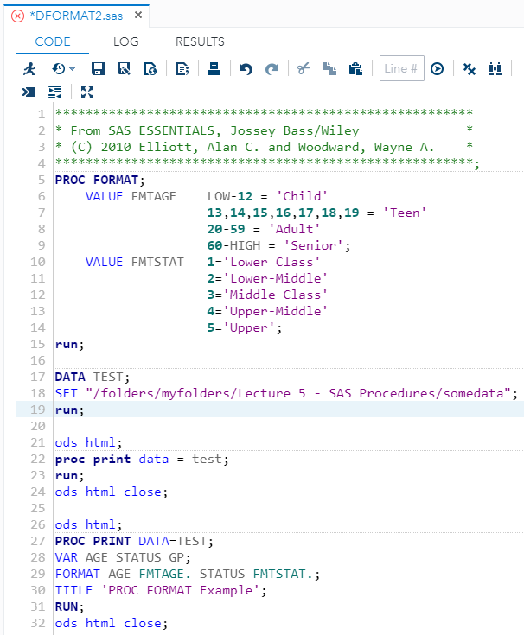
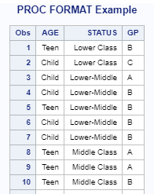
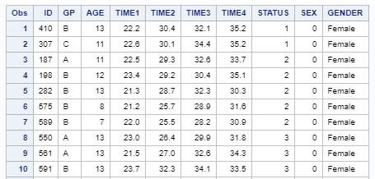
Formatting Display Output
Example: In the editor window, open the file DFORMAT2.SAS

Slide 4
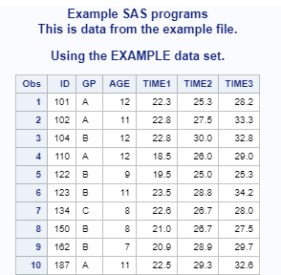
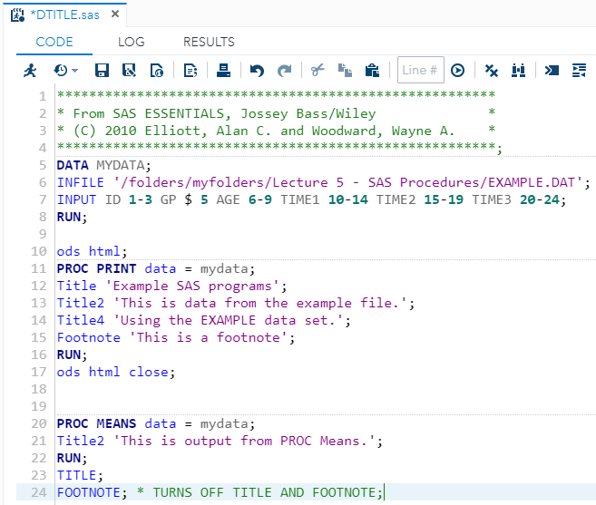
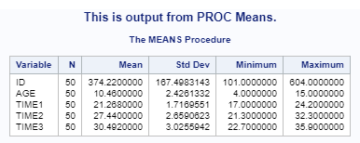
Using Title and Footnotes Statements
The ‘Title’ statement places text at the top of each output.
The ‘Footnote’ statement places text at the end of each output.
To delete a title or footnote simply declare the ‘Title’ or ‘Footnote’ statement without any text.
Example: In the editor window, open the file DTITLE.SAS

Slide 5
Including comments in your SAS code
Add comments in your program as explanatory text
Comments allow you to understand your code better
Comments can be added in two ways:
Placing text between /* and */ (e.g. /*My Comment*/ )
Placing text between * and ; (e.g. *My Comment; )
All commented text should be green

Slide 6
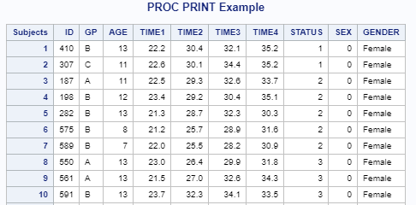
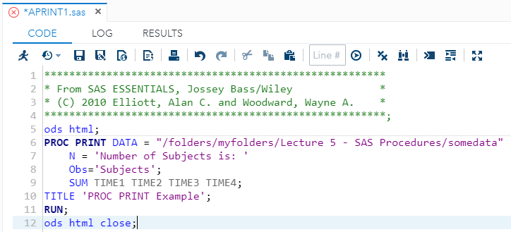
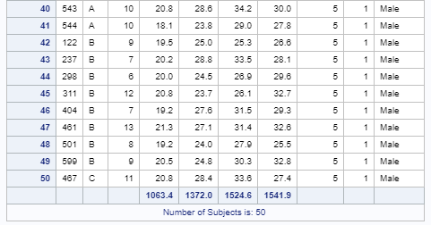
Modifying Proc Print
Specify these options in the proc statement
“double” – double spaces the output
“label” – allows you to include any labels
“N = “- Declares a heading and calculates a count for the number of observations
“OBS = “- Specifies a label for the observation number column
“ROUND “– rounds the values
Example: In the editor window, open the file APRINT1.SAS

Slide 7
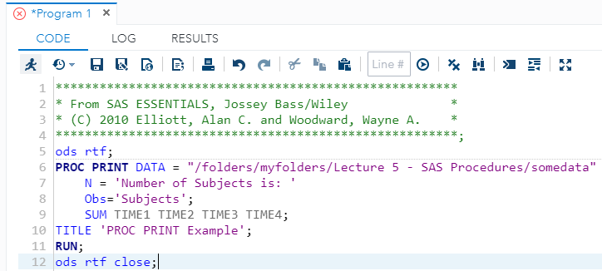
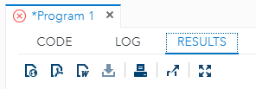
ODS Output Delivery System
Enhance your output using the ODS output statement
Declare “ODS HTML; ” before the output you want to enhance
Close the ODS output using the “ODS HTML close; ” directly after the code for the output that you want to enhance
You can replace “HTML” with PDF, RTF, etc. depending on the output you want.
HTML is the default format from SAS9.4 onwards.
Example: In the editor window, open the file APRINT1.SAS

Slide 8
Study
Chapter 5
Matthew Valentine
Office: Tech Room Lab K2
Mvalentine@uwc.ac.za

